Slide 1

Sequential Circuits
Notes:
目录

Slide 2
Two Types of Switching Circuits
Combinational Circuits
Combinational circuits have only input and output. Output depends on input.
Example: AND,OR,NAND,NOR,XOR etc
Sequential Circuits
Sequential circuits have input, present state, next state and output. Next state depends upon present state and input. Output depends upon present state and input
Example: Flip-Flops etc

Slide 3
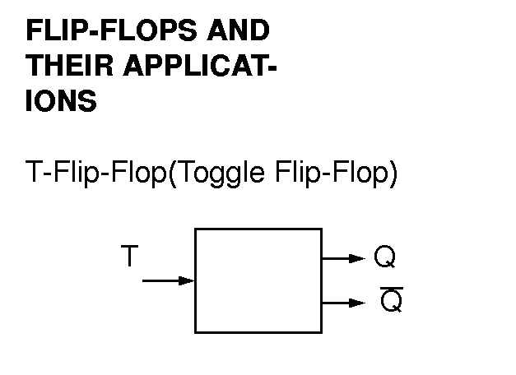
Flip Flops and Their Applications

Slide 4
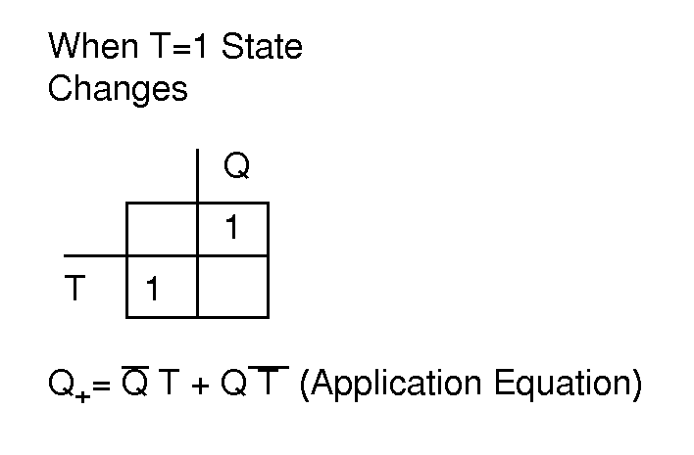
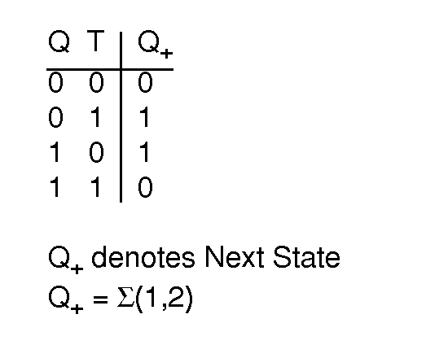

Slide 5
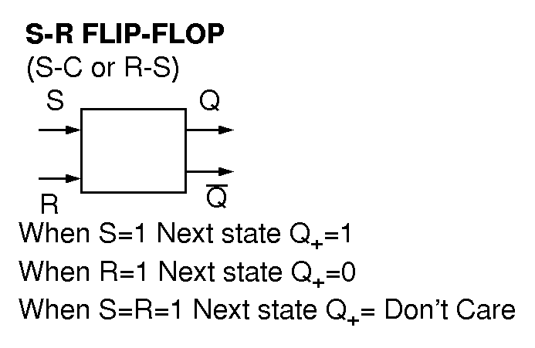

Slide 6
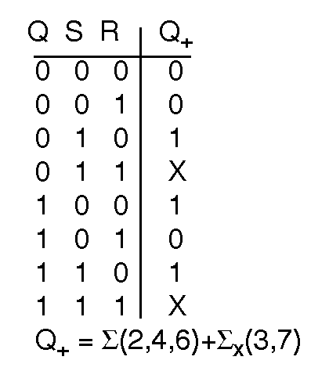
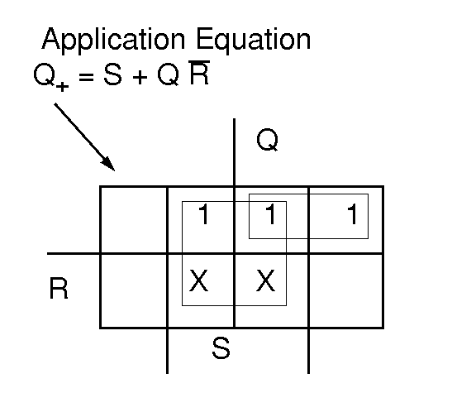

Slide 7
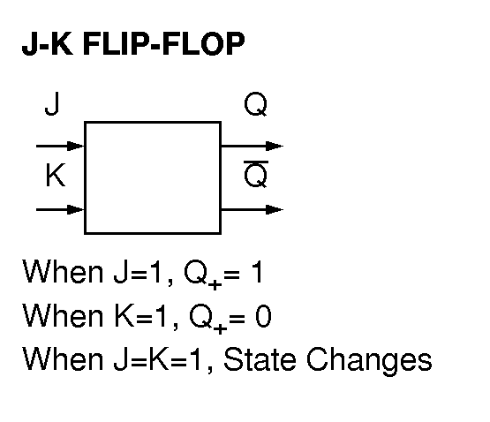

Slide 8
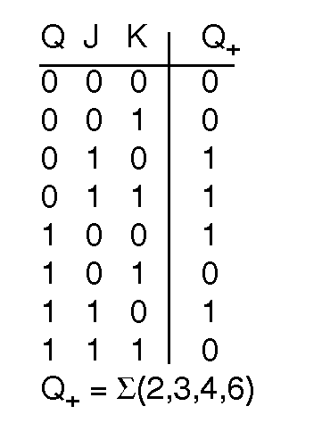
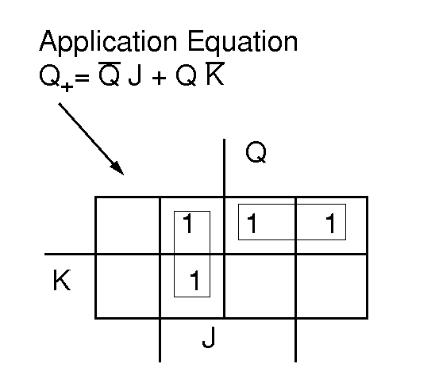

Slide 9
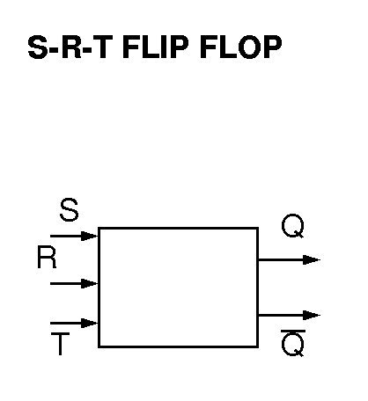
S-R-T FLIP FLOP
When S = 1, Q₊ = 1
When R = 1, Q₊ = 0
When T = 1, State changes
When any two out of S,R,T equals 1, we have don’t care

Slide 10
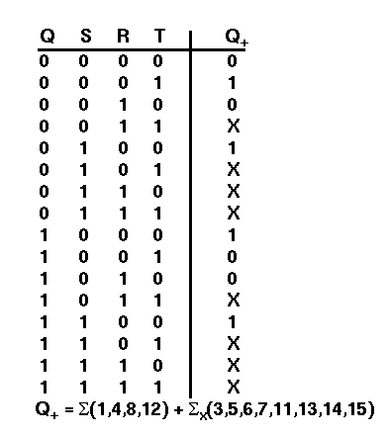
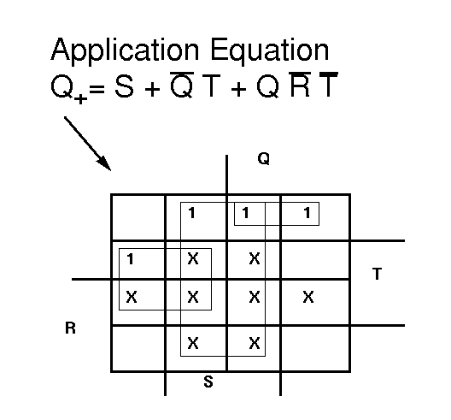

Slide 11
Example 1:
Design a modulo-8 binary -up counter using T- Flip Flop
Modulo 8 counter :
Counts up to 7 . So we need three Flip-flops for eight states

Slide 12
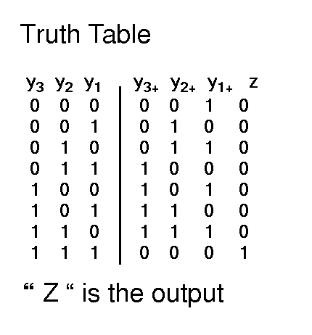
modulo-8 counter

Slide 13
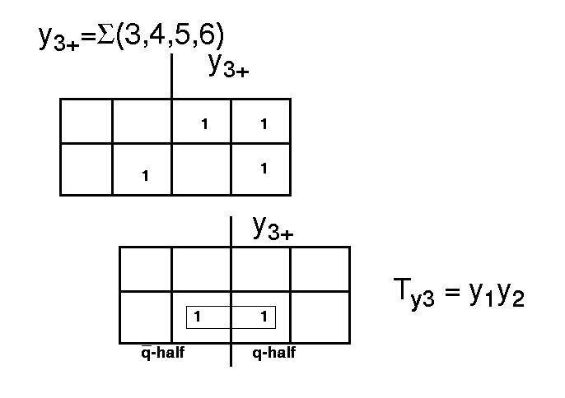
modulo-8 counter

Slide 14
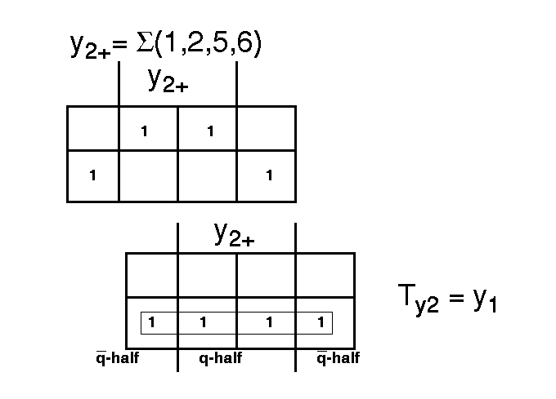
modulo-8 counter

Slide 15
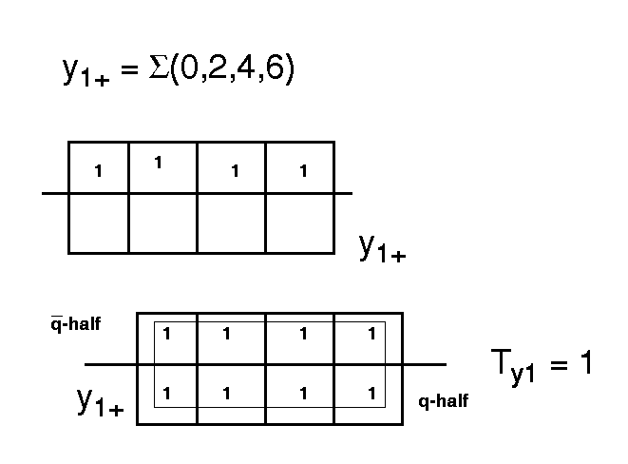
modulo-8 counter

Slide 16
Example 2:
Design a modulo-8 binary -up counter using
T- Flip Flop with input x
Modulo 8 counter :
Counts up to 7 . So we need three Flip-flops for eight states

Slide 17
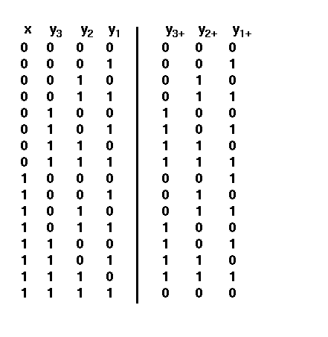
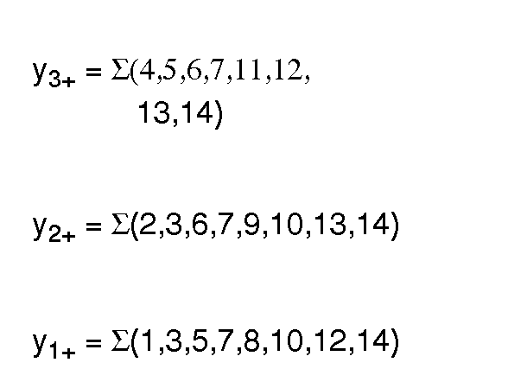
modulo 8 counter with I/p x

Slide 18
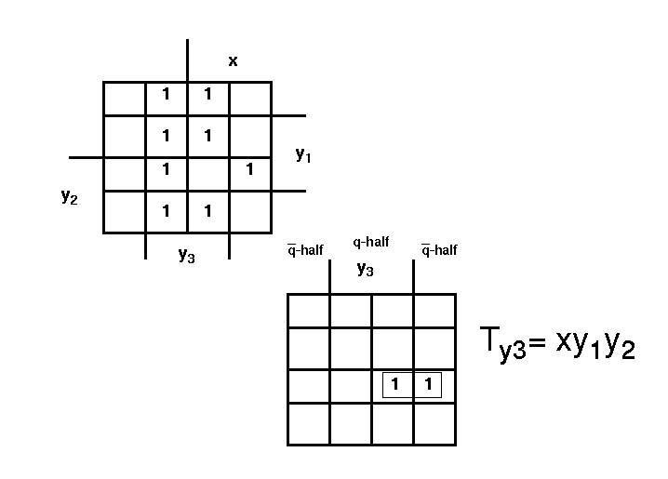
modulo 8 counter with I/p x

Slide 19
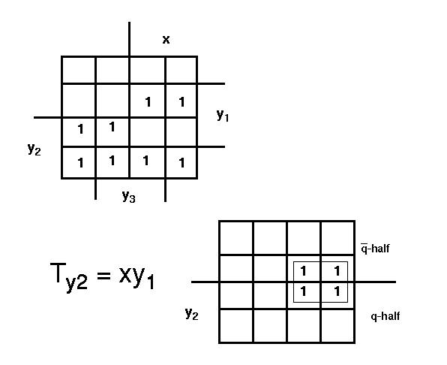
modulo 8 counter with I/p x

Slide 20
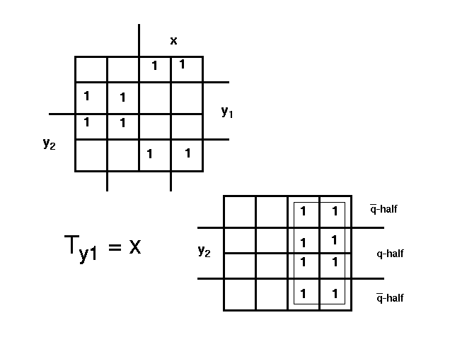
modulo 8 counter with I/p x

Slide 21
Example 3:
Design a binary decade counter using SR- Flip Flop without input x
Decade Counter:
Counts up to 9 . So we need four Flip-Flops
for ten states

Slide 22
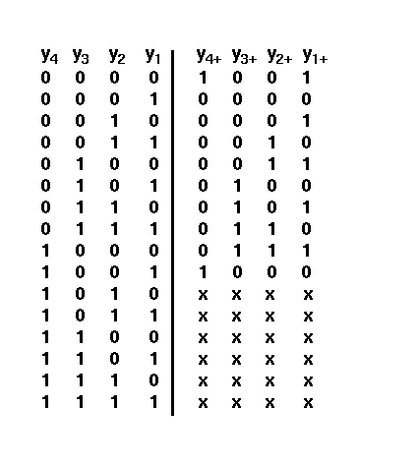
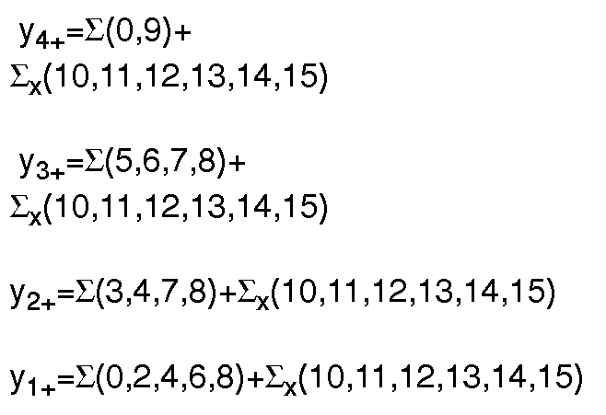
Binary Decade counter

Slide 23
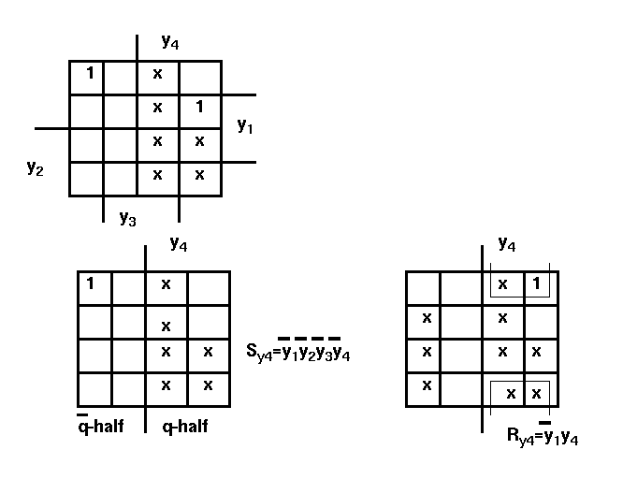
Binary Decade counter

Slide 24
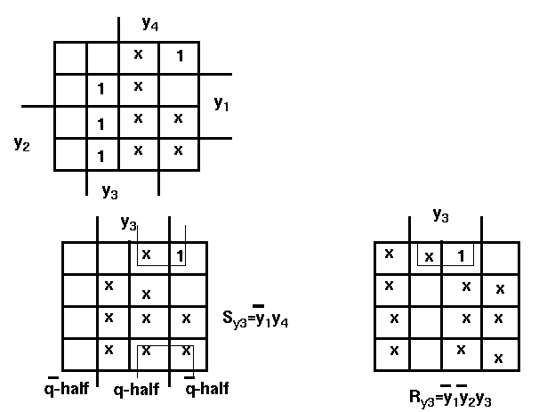
Binary Decade counter

Slide 25
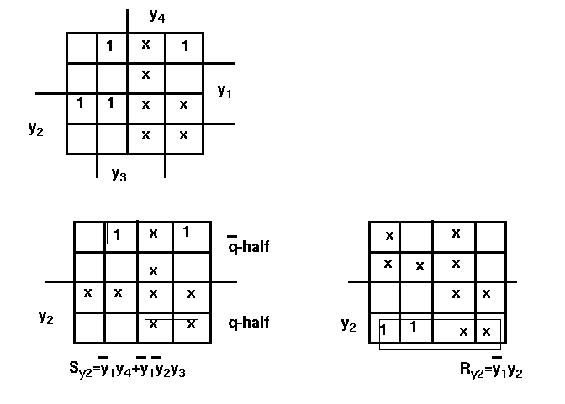
Binary Decade counter

Slide 26
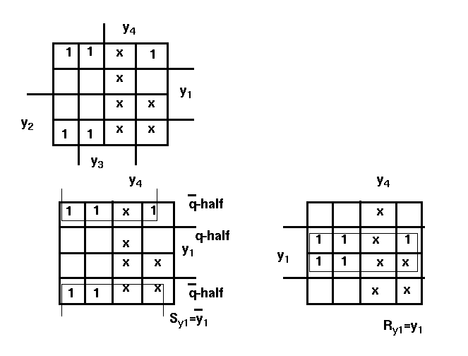
Binary Decade counter

Slide 27
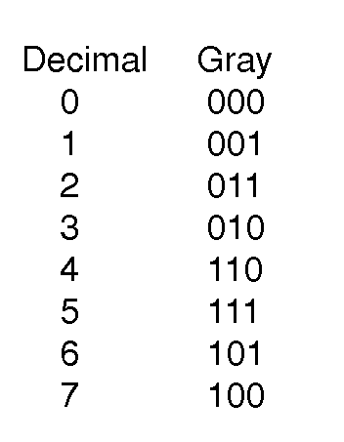
Example 4:
Design a modulo-8 counter which counts in the way specified below, use J-K Flip-Flop.

Slide 28
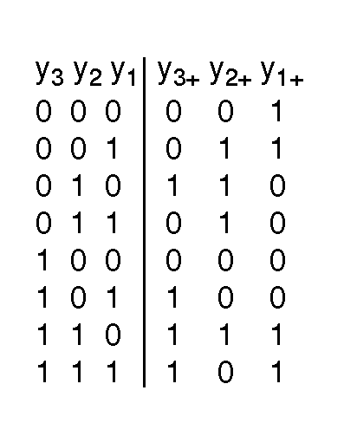
TRUTH TABLE:
present state
next state

Slide 29
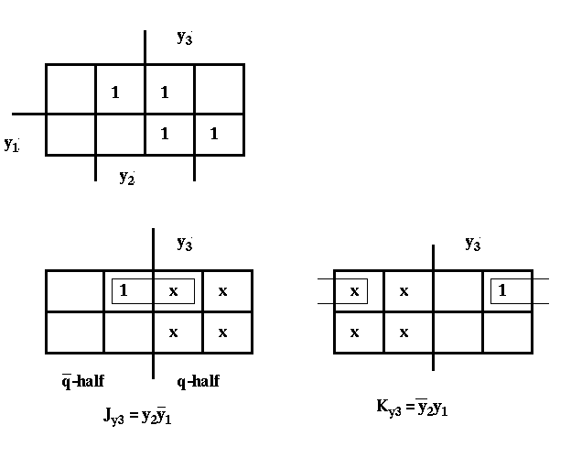
Gray code counter
Y₃

Slide 30
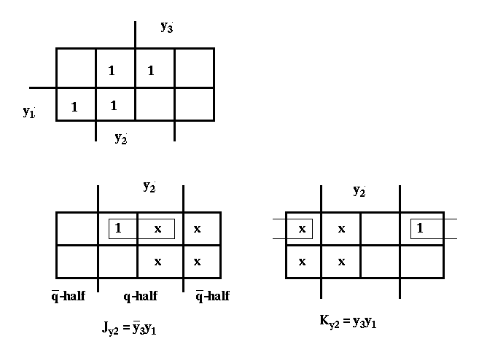
Gray code counter:
Y₂

Slide 31
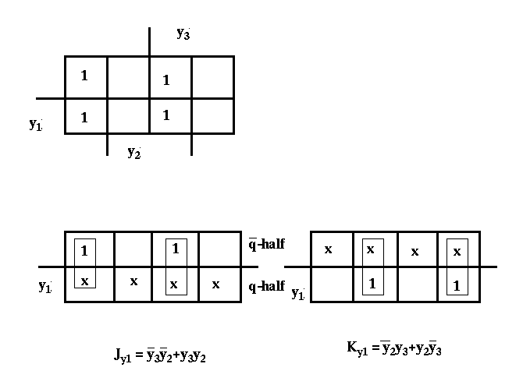
Gray code counter:
Y₁

Slide 32
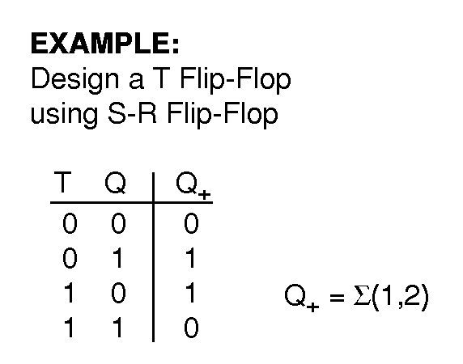
Example 5:
Design a T-Flip-Flop using S-R Flip-Flop
Sol:

Slide 33
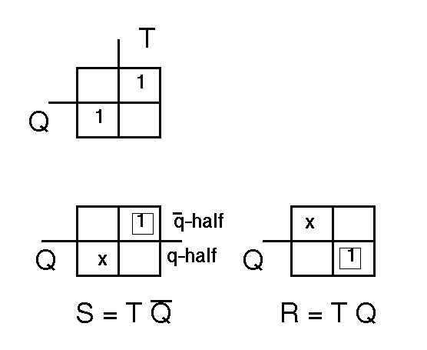
T Flip flop using S-R flipflop

Slide 34
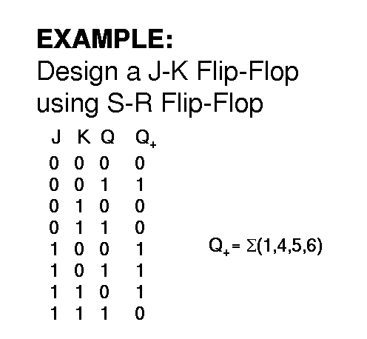
Example 6:
Design a J-K Flip Flop using S-R Flip Flop
Sol:

Slide 35
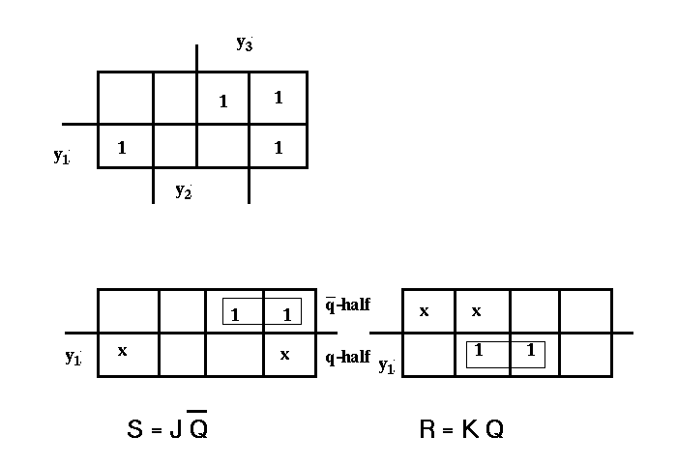
J-K Flip Flop using S-R Flip Flop

Slide 36
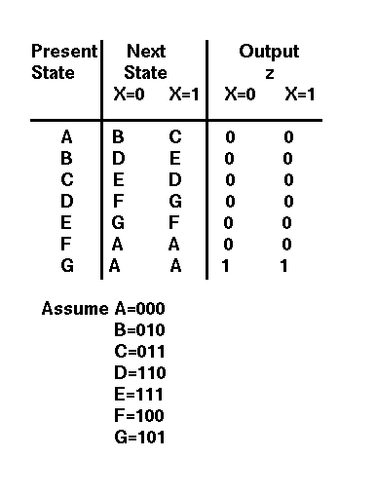
Example 7:
Design a sequential circuit given below using J-K FlipFlop

Slide 37
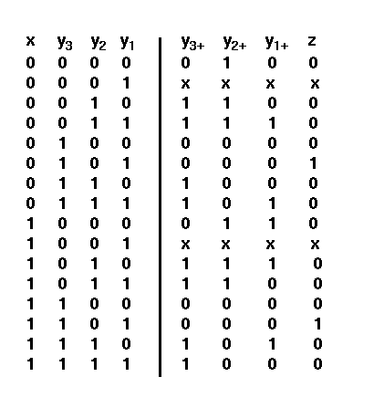
Truth Table:
I/p
Present st.
Next state
o/p

Slide 38
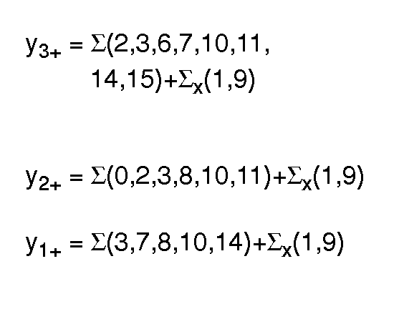
Design of Seq. Circuit

Slide 39
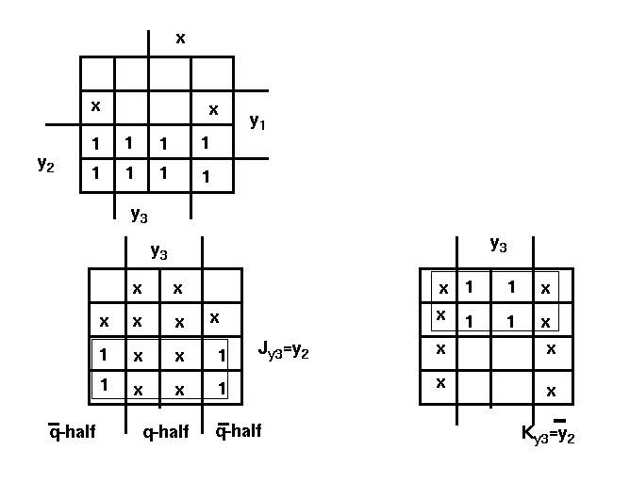
Design of Seq. Circuit

Slide 40
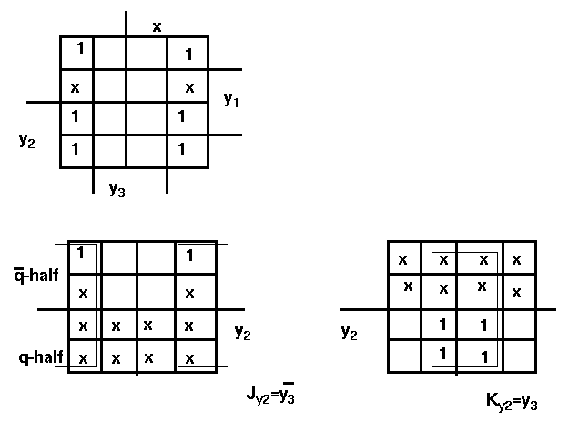
Design of Seq. Circuit

Slide 41
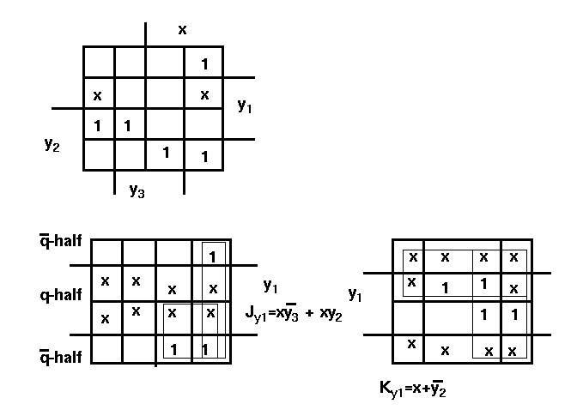
Design of Seq. Circuit

Slide 42
Example 8:
Design a binary modulo-5 counter using SRT- Flip Flop with input x
Modulo-5 Counter:
Counts up to 4 . So we need three Flip-Flops for five states

Slide 43
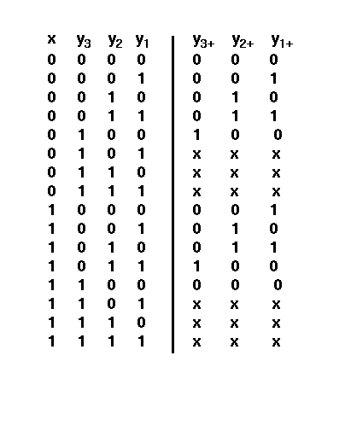
Binary Modulo-5 counter
STATE TABLE

Slide 44
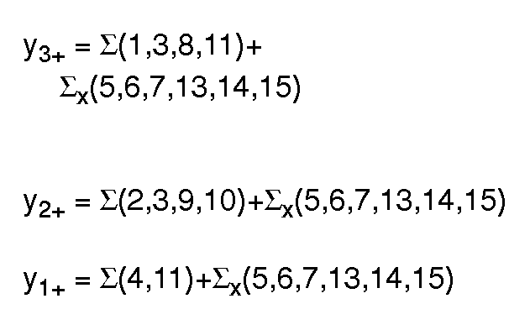
Binary Modulo-5 counter

Slide 45
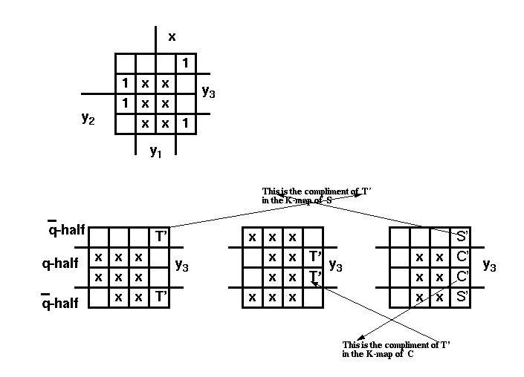
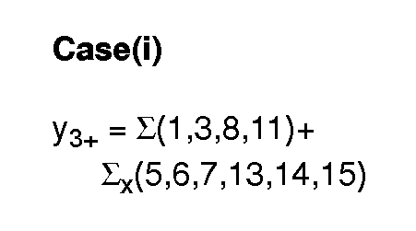
Binary Modulo-5 counter

Slide 46
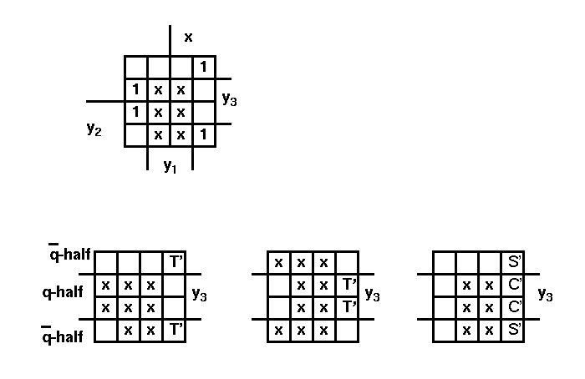
Binary modulo-5 counter
Note: Here S’and C’ stands for the compliment value of the corresponding cells in the S and C K-maps
Assume T’ =
So S’ and C’ comes out to be

Slide 47
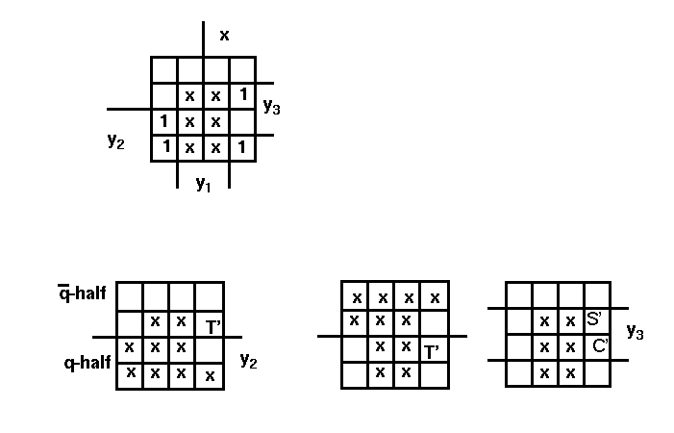
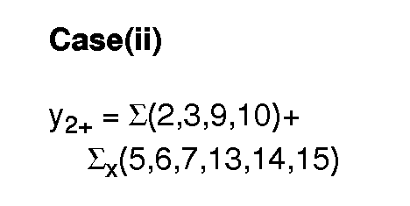
Binary Modulo-5 counter

Slide 48
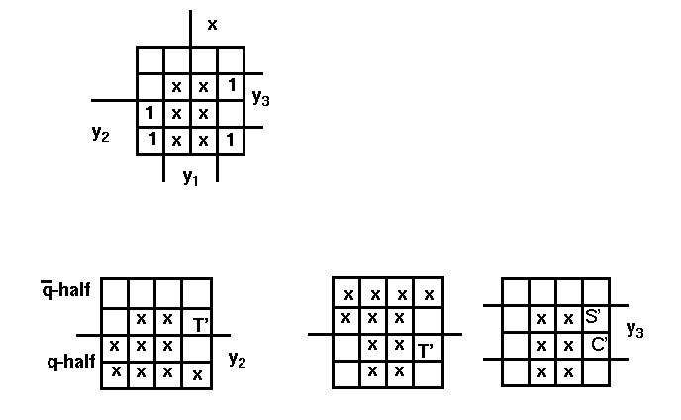
Binary modulo-5 counter
Assume T’ =
So S’ and C’ comes out to be

Slide 49


Binary modulo-5 counter

Slide 50

Binary modulo-5 counter
Assume T’ = 1
So S’ and C’ comes out to be
0 and 0

Slide 51

Modulo 5 binary up-counter
STATE TABLE

Slide 52

Modulo 5 binary up-counter

Slide 53

Modulo 5 binary up-counter

Slide 54

Modulo 5 binary up-counter

Slide 55

Modulo 5 binary up-counter

Slide 56
Example 10:
Design an Octal up-counter (Binary counter) using S-C Flip-Flop using Tabular Method
Octal up counter:
Counts up to 7 . So we need three Flip-Flops for seven states

Slide 57

Octal up counter
STATE TABLE

Slide 58

Octal up counter

Slide 59

Octal up counter

Slide 60

Octal up counter

Slide 61

Rules To Derive Excitation Function
T- Flip-Flop

Slide 62

S-C Flip Flop

Slide 63

J-K Flip Flop

Slide 64

Summary of Rules for all Flip-Flops

Slide 65

Modified Rules For The Flip-flops

Slide 66


Slide 67


Slide 68


Slide 69


Slide 70


Slide 71


Slide 72
questions ???

